Slide 1
An analysis of rental prices by towns in Singapore
Applied Data Science Capstone Project
By Amber Zhao Qinyu

Slide 2
Introduction
Singapore is a country that constantly faces an influx of foreigners
Many foreigners are simply introduced to expensive condominiums in city centre by agents without much knowledge of other options available
This study will:
Provide an overview of rental prices of public housing in Singapore
Attempt to analyse the relationship between rental prices and the types of surrounding amenities in the neighbourhood

Slide 3
Data Acquisition
Latest Rental Prices
Obtained from the official Singapore government data bank - https://data.gov.sg
Amenities in each town
Obtained from FourSquare API
Geojson file of Singapore map
Obtained from other user’s project on Github

Slide 4
Data CLeaning
Extra unnecessary data from the data bank was dropped, and dataframe was restructured for easier analysis
Geojson file was edited so that the names given to the areas are consistent with the main dataframe

Slide 5
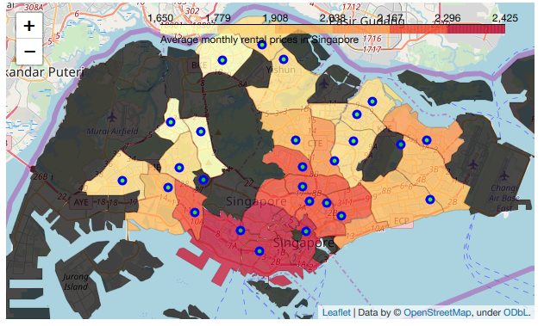
Results
Rental prices are the highest in city centre
Lowest in west and north region furthest away from city centre
Black parts are either non-residential areas or have too few public housing available for rent

Slide 6
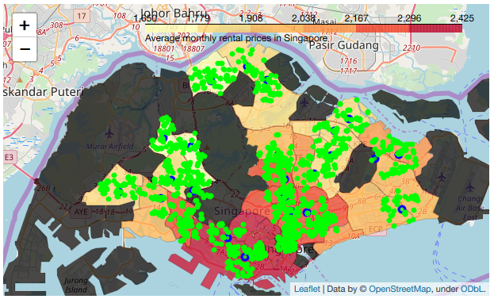
Results
Plotting the top amenities in each town obtained from Foursquare provided no insight

Slide 7
Results
Linear Regression Analysis was done but produced low R2 score and high MSE
Venues with most positive effect: Pakistani Restaurant, Mountain, Organic Grocery, Cupcake Shop, Bridge, Garden, Chinese Breakfast Place, Video Game Store, Hot Dog Joint, Motorcycle Shop
Venues with most negative effect: College Theatre, Smoke Shop, Post Office, College Gym, Portuguese Restaurant, Diner, Light Rail Station, Food & Drink Shop, Electronics Store, Club House
R2 Score | 0.439
Mean Squared Error | 0.293

Slide 8
Results
Redoing the analysis after Principal Component Analysis provided better R2 score and lower MSE
Venues with most positive effect: Dessert Shop, Performing Arts Venue, Yoga Studio, Cocktail Bar, Bakery, Hotel, Sporting Goods Shop, Lounge, Dumpling Restaurant, Ramen Restaurant
Venues with most negative effect: Fast Food Restaurant, Sandwich Place, Steakhouse, Sushi Restaurant, Supermarket, Bus Station, Shopping Mall, High School, American Restaurant, Trail
R2 Score | 0.890
Mean Squared Error | 0.089

Slide 9
Conclusions
The results from analysis do not tally with our common sense – correlation does not imply causation
Nevertheless a good overview for foreigners new to Singapore to have a sense of how rental prices are like
Proves that the most expensive places may not be the most convenient
Such analysis could prove more insightful when done on a micro scale

